Slide 1
Infrared spectrometry and mass spectrometry...
By Blapchemistry (BTEC SPORT)

Slide 2
Organic molecules...
Organic molecules are ones which consist of hydrogen and carbon atoms bonded together.
The name of these molecules comes from the number of carbon molecules present.
In this “quest” all of the molecules have the prefix “prop” showing that each molecule has 3 carbon atoms present.

Slide 3
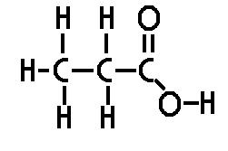
Propanoic acid.
This is the functional group that tells us that the molecule is an example of a carboxylic acid.

Slide 4
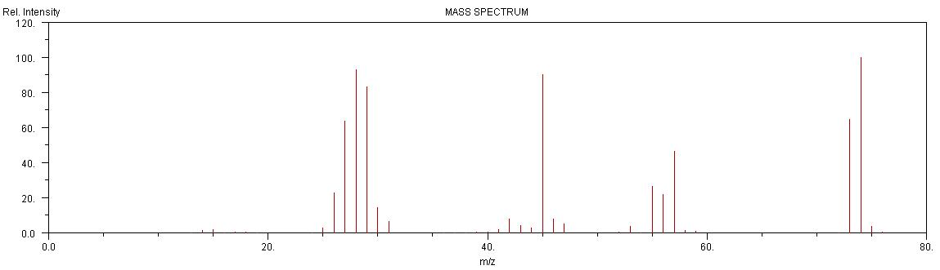
Mass spectrometry for Propanoic acid.
The molecular formula for Propanoic acid is C3H6O2. This has an Mr (molecular mass) of 74. The largest peak to the right of the mass spectrum below is situated at 74, so we know that this is showing Propanoic acid.

Slide 5
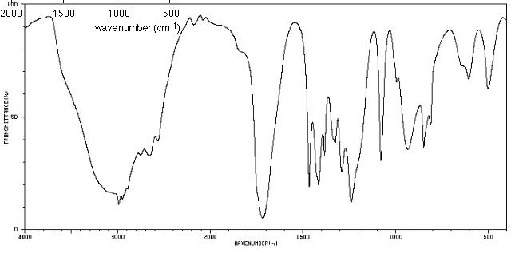
Infrared spectrometry for
Propanoic acid.
The spectrum below shows evidence of Propanoic acid. We know this because carboxylic acids have O-H bonds present and this is shown with a wide peak at around 3000 cm (wavenumber). The other key peak is shown at 1700 displaying a C=O bond is present, another main part of the functional group that is a carboxylic acid.

Slide 6
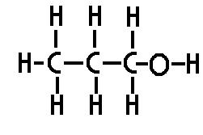
Propan-1-ol
This functional group –O-H displays that the molecule is an alcohol. It is known as propan-1-ol as 3 carbons are present in the molecule and the alcohol functional group is found off of the 1st carbon atom from the right of the molecule.

Slide 7
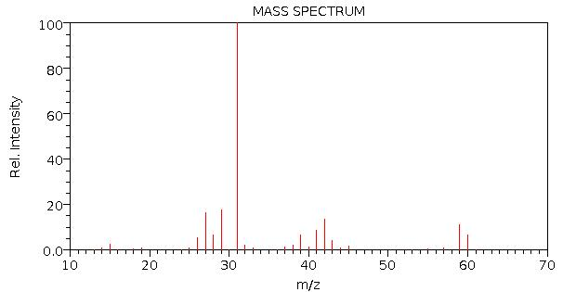
Mass spectrometry for propan-1-ol
The molecular formula for propan-1-0l is C3H7OH. It has an Mr (molecular mass) of 60. The furthest noticeable peak to the right of this mass spectrum is displayed at 60, so we know this spectrum is showing a propan-1-ol molecule.

Slide 8
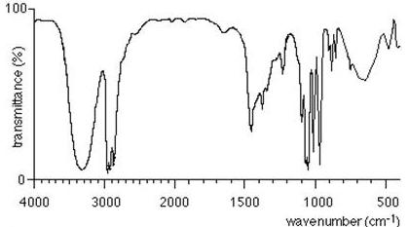
Infrared spectrometry for propan-1-ol
The spectrum below shows that propan-1-ol is present. We know this because alcohols functional group is OH and there is a broad peak around 3000 cm (wavenumber) displaying the presence of an OH bond.

Slide 9
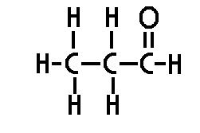
Propanal.
This molecule is propanal. We know this as it contains 3 carbon atoms and one of the end carbon atoms is joined to an oxygen atom by a double bond. This C=O is the functional group to display an aldehyde.

Slide 10
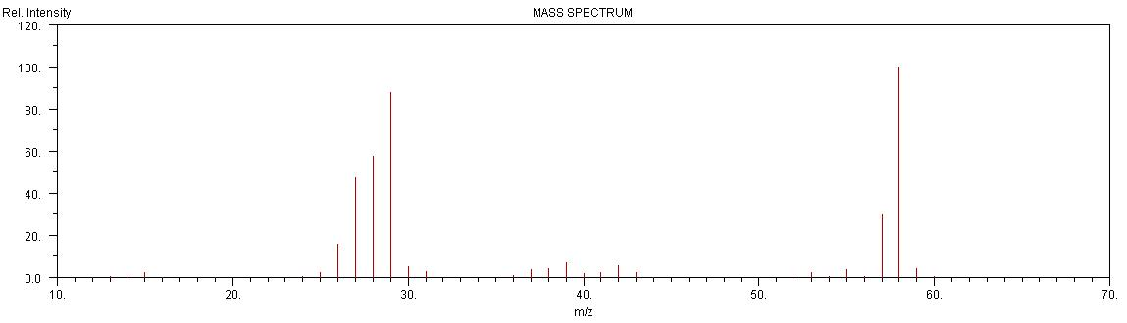
Mass spectrometry for propanal.
The molecular formula of propanal is C3H6O. It has an Mr (molecular mass) of 58. The furthest noticeable peak is at 58 and there is also a large peak at 29 where the COH fragment of the molecule would be found.

Slide 11
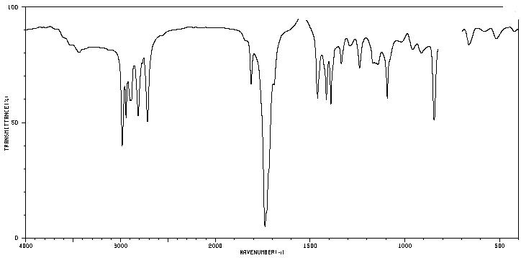
Infrared spectrometry for propanal.
We know that this is the infrared spectrometry for propanal as there is a large peak at 1700 displaying the C=O.

Slide 12
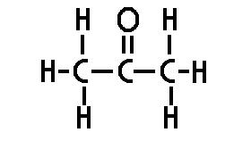
Propanone.
This is the functional group displaying that the molecule is a ketone.

Slide 13
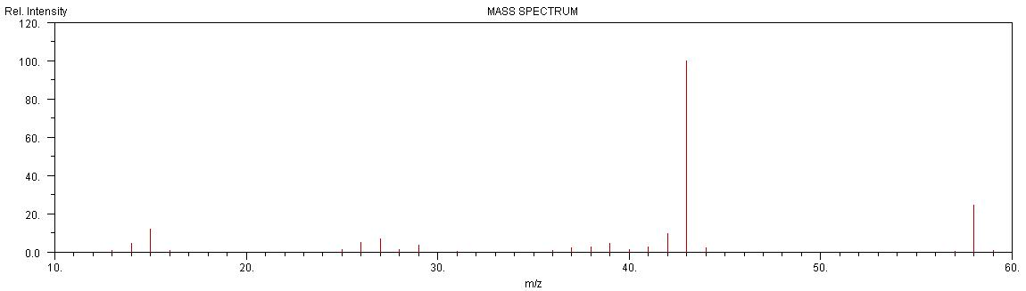
Mass spectrometry for Propanone.
The molecular formula for propane is C3H6O. The Mr (molecular mass) of Propanone is 58. There is a large peak at the right of the spectrometry at 58 showing that the molecule is Propanone.

Slide 14
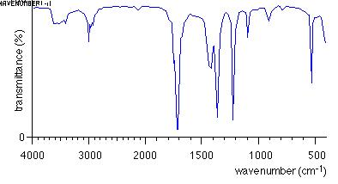
Infrared spectrometry for Propanone.
We know this is Propanone as there is a large peak around 1700 cm (wavenumber) displaying the presence of a C=O bond.

